Slide 1
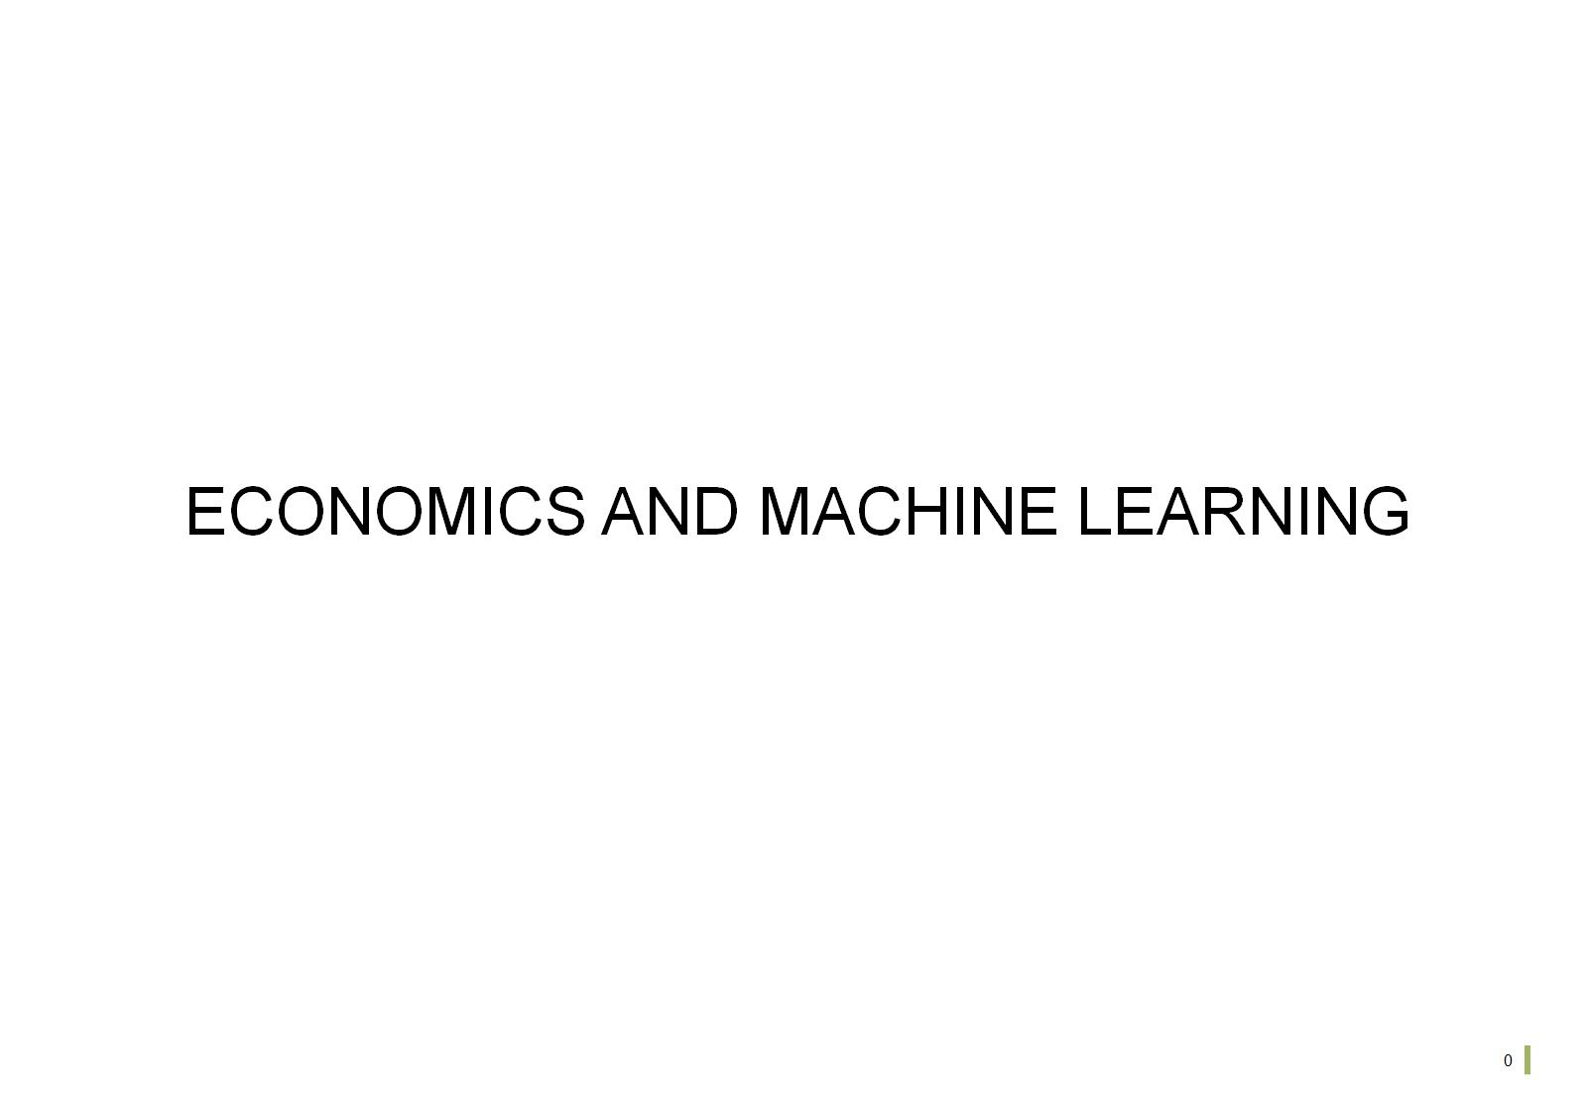

Slide 2
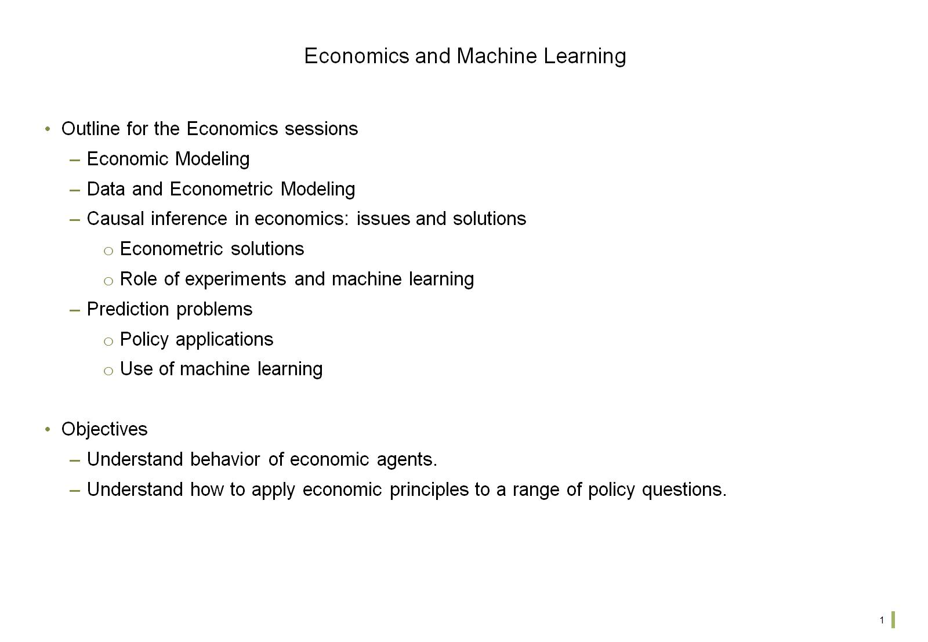
Economics and Machine Learning

Slide 3
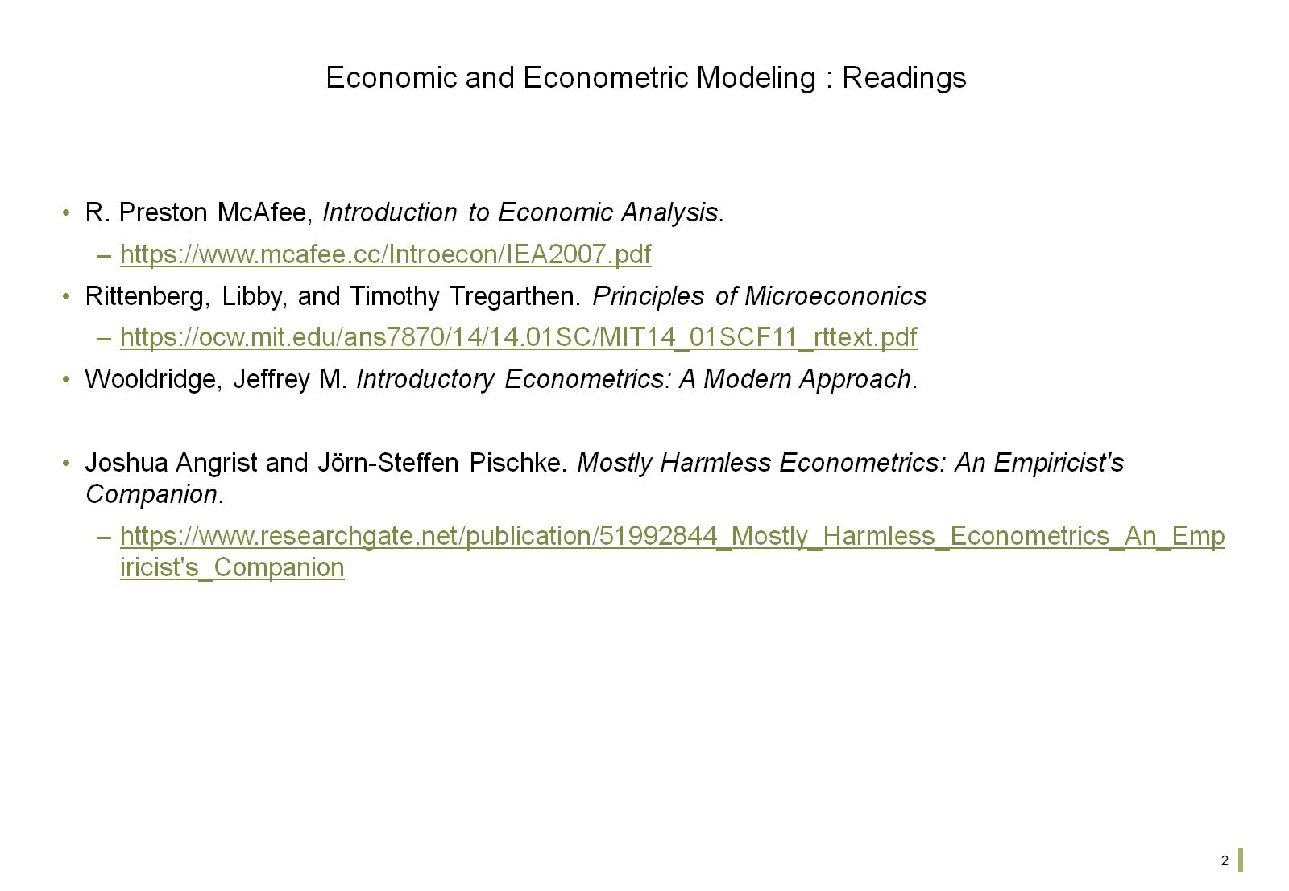
Economic and Econometric Modeling : Readings

Slide 4
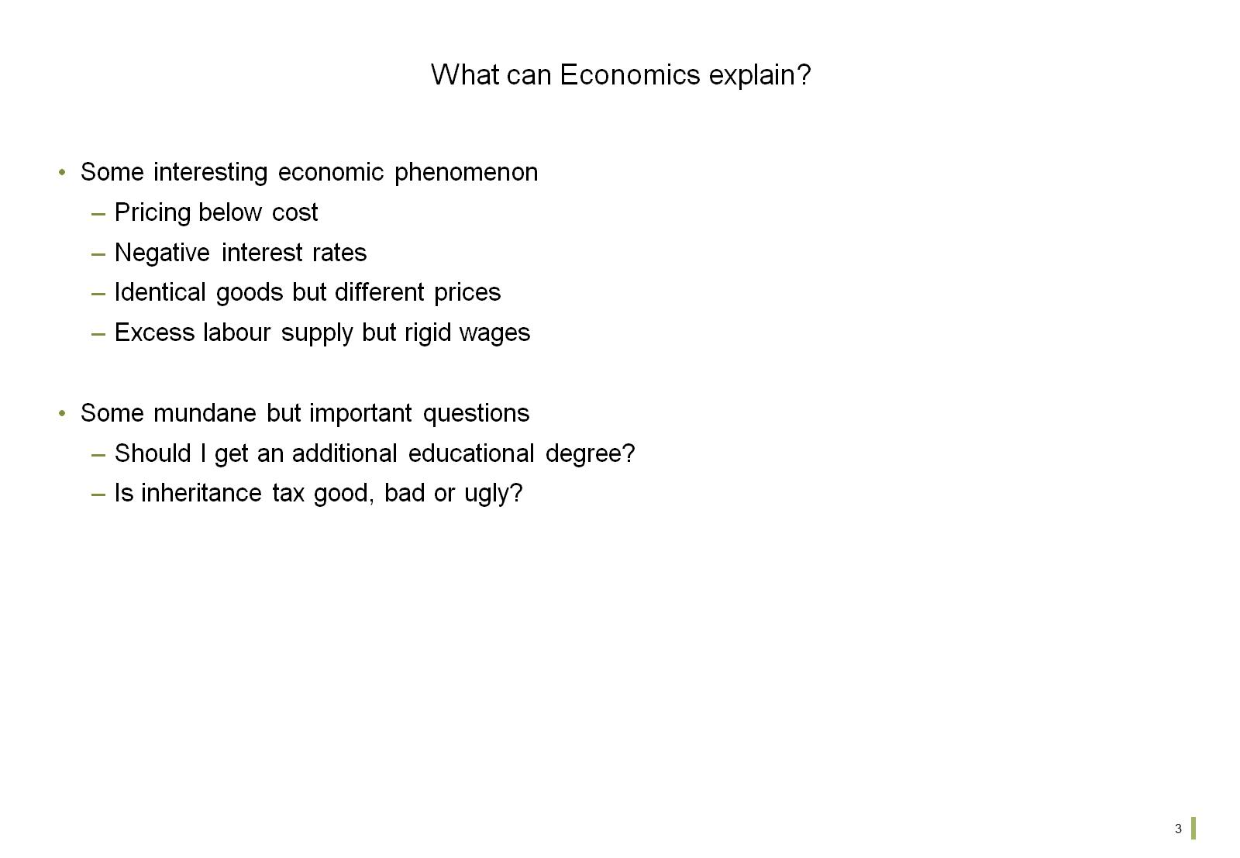
What can Economics explain?

Slide 5
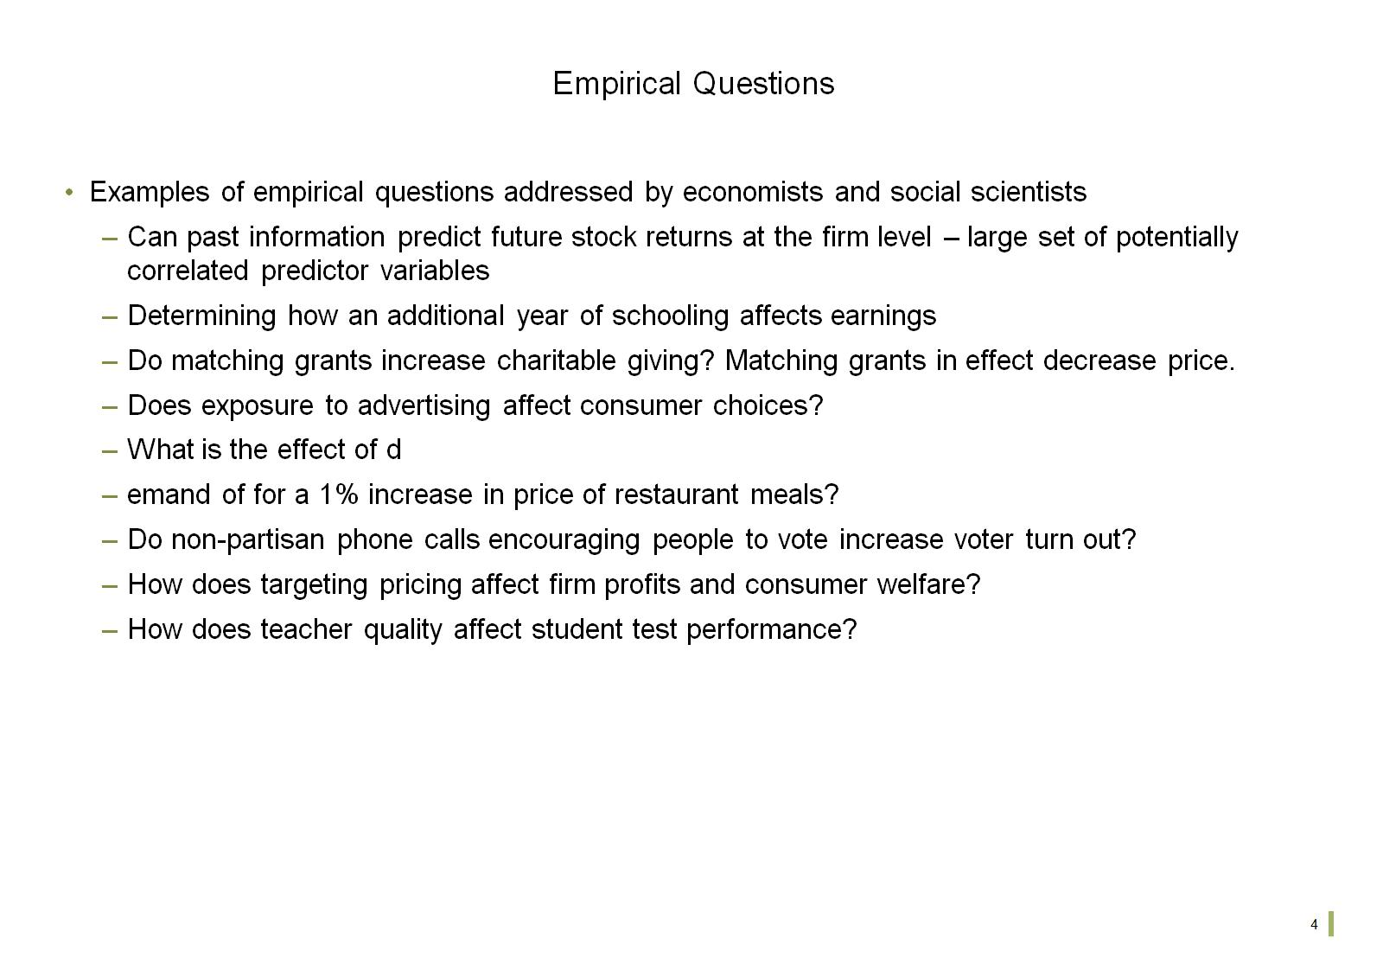
Empirical Questions

Slide 6
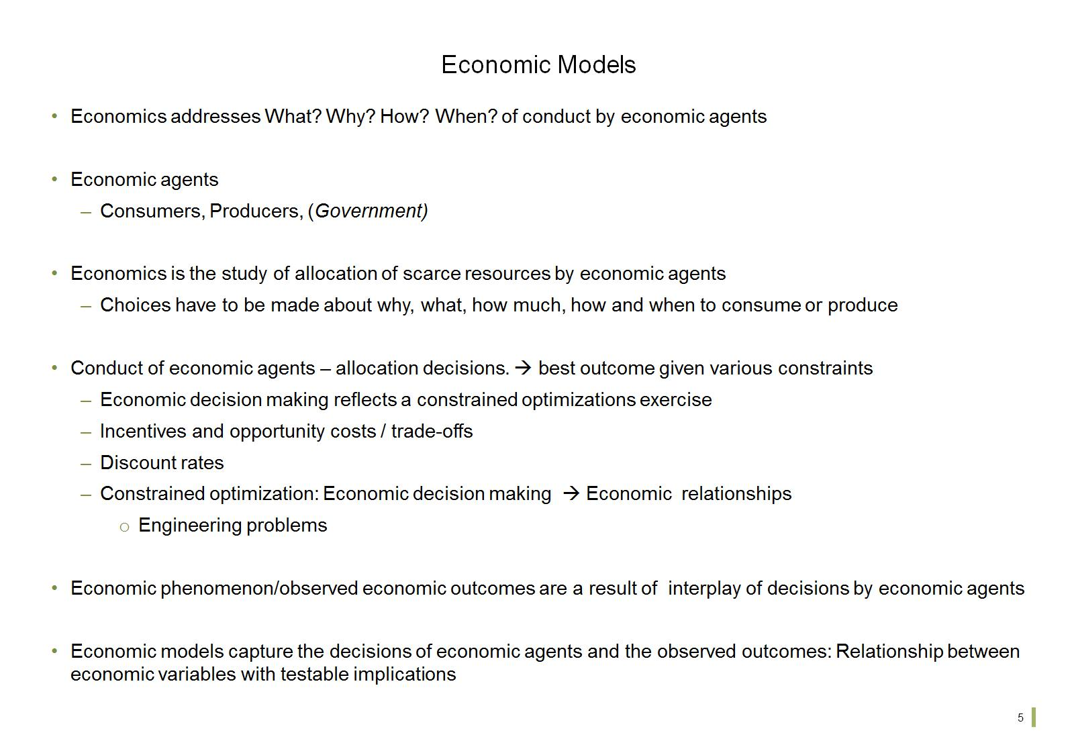
Economic Models

Slide 7
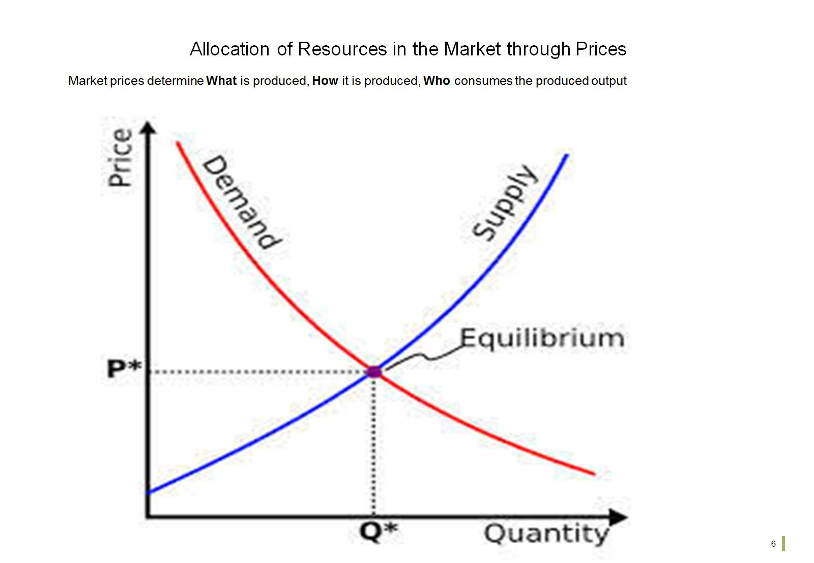
Allocation of Resources in the Market through Prices

Slide 8
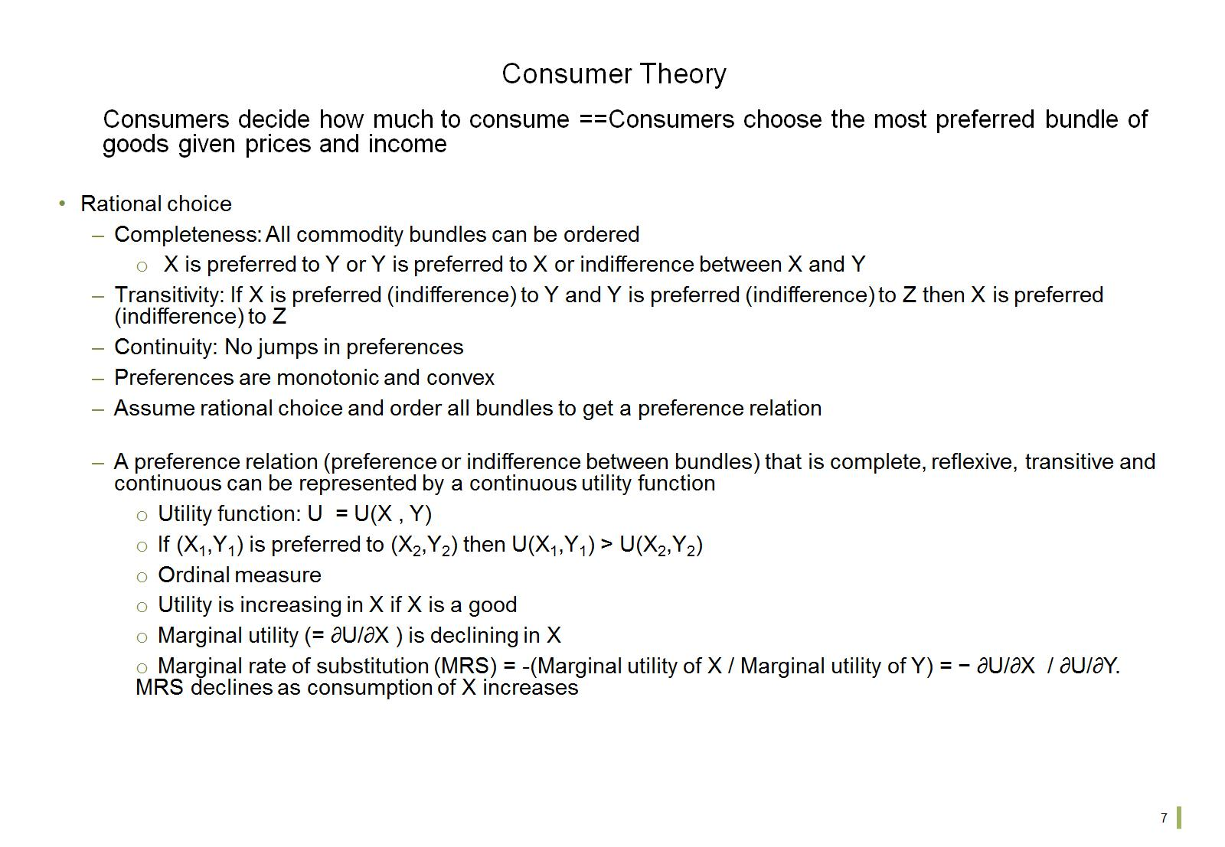
Consumer Theory

Slide 9
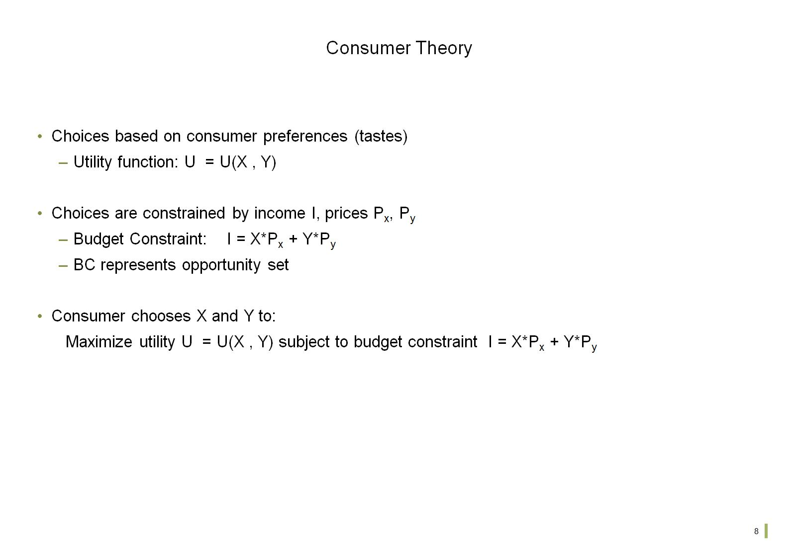
Consumer Theory

Slide 10
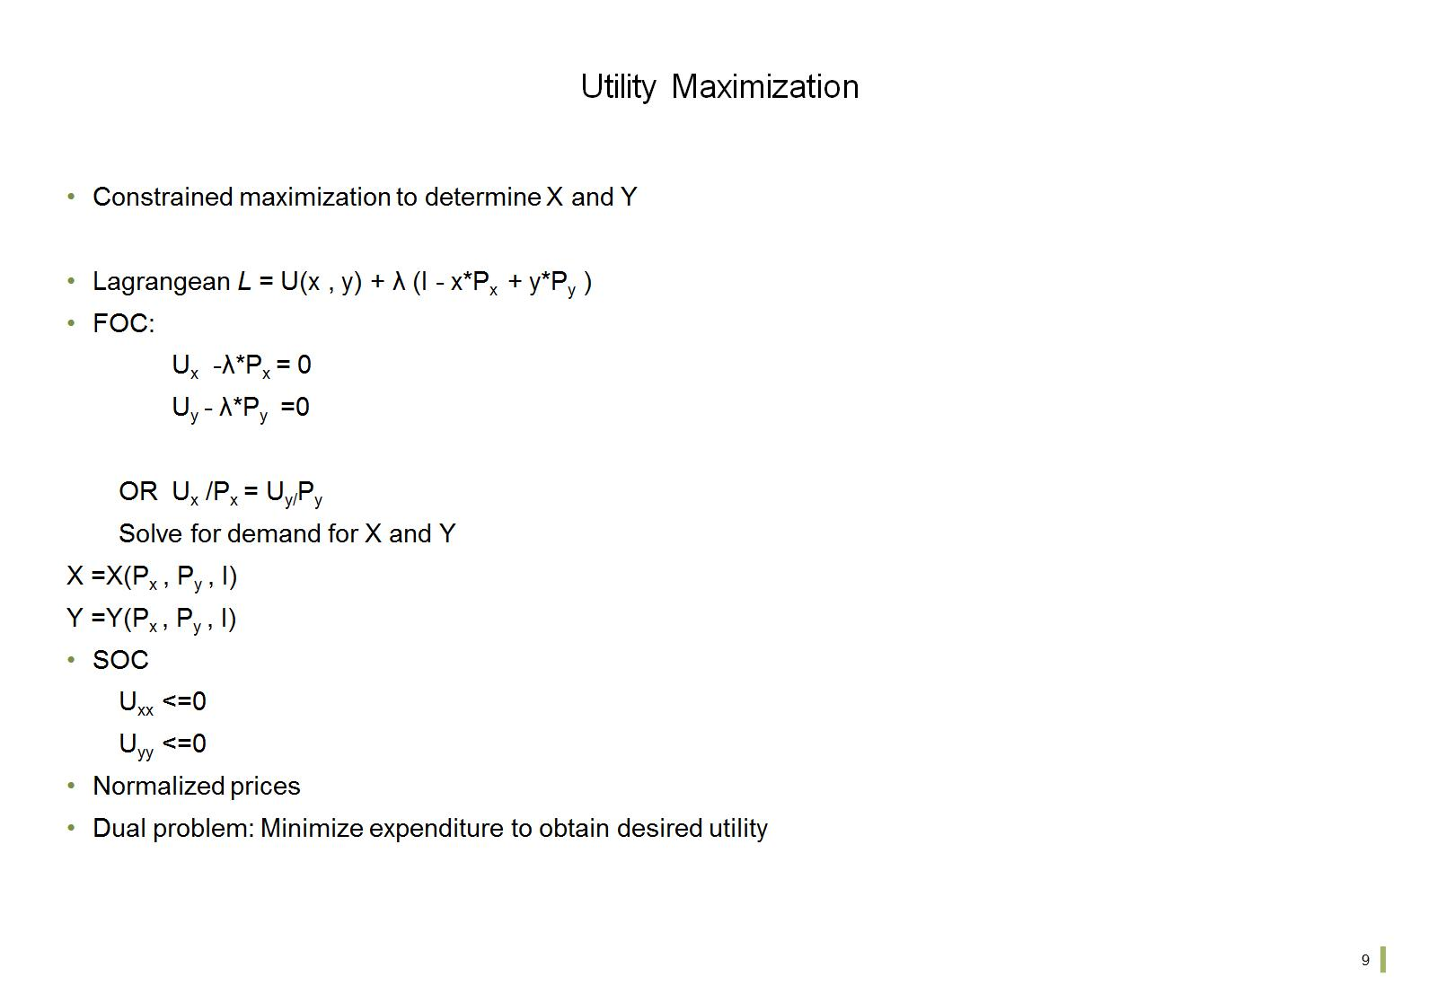
Utility Maximization

Slide 11
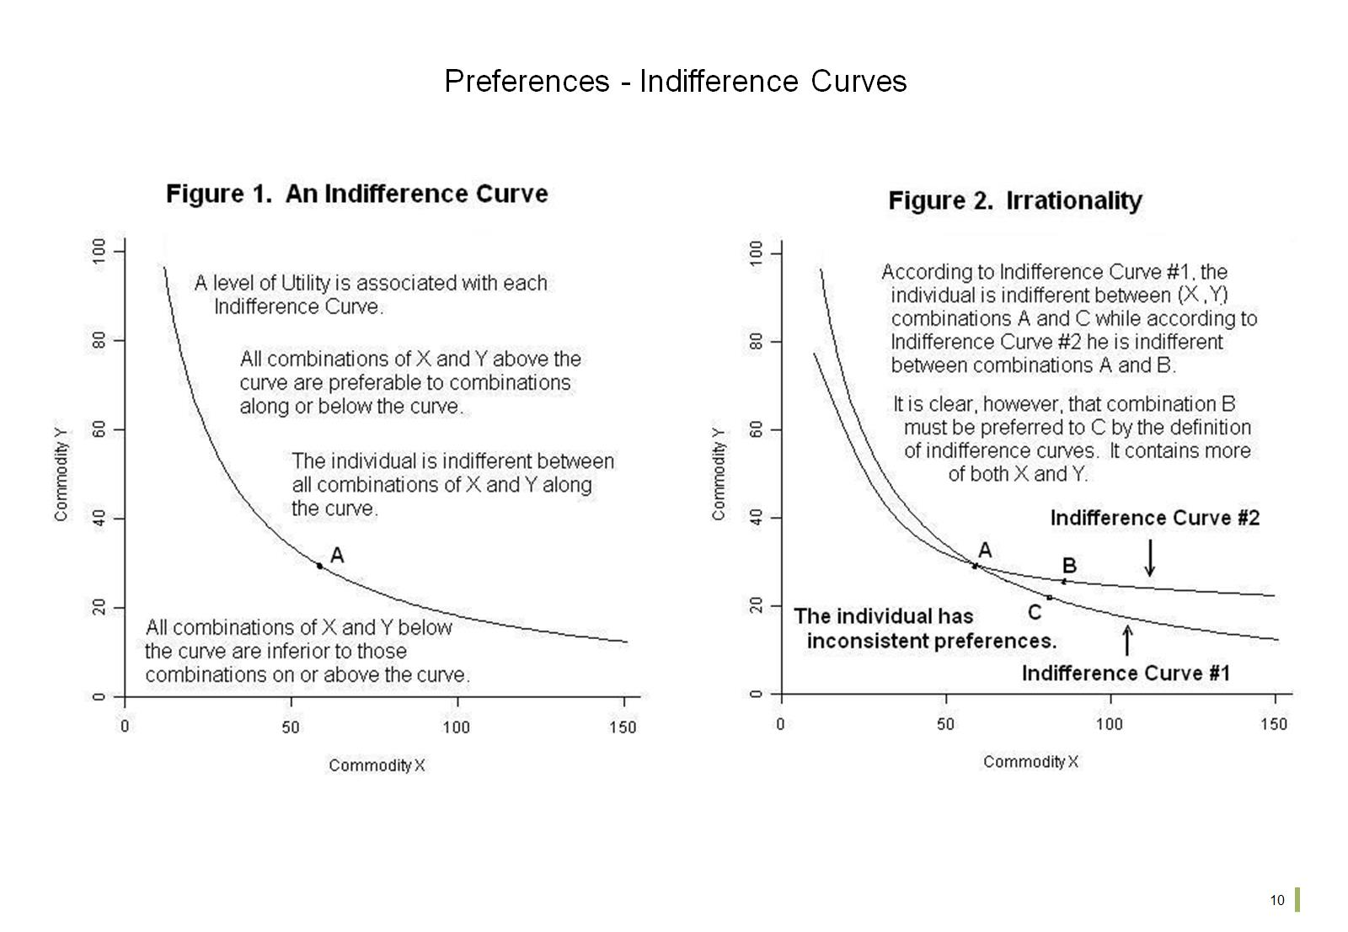
Preferences - Indifference Curves

Slide 12
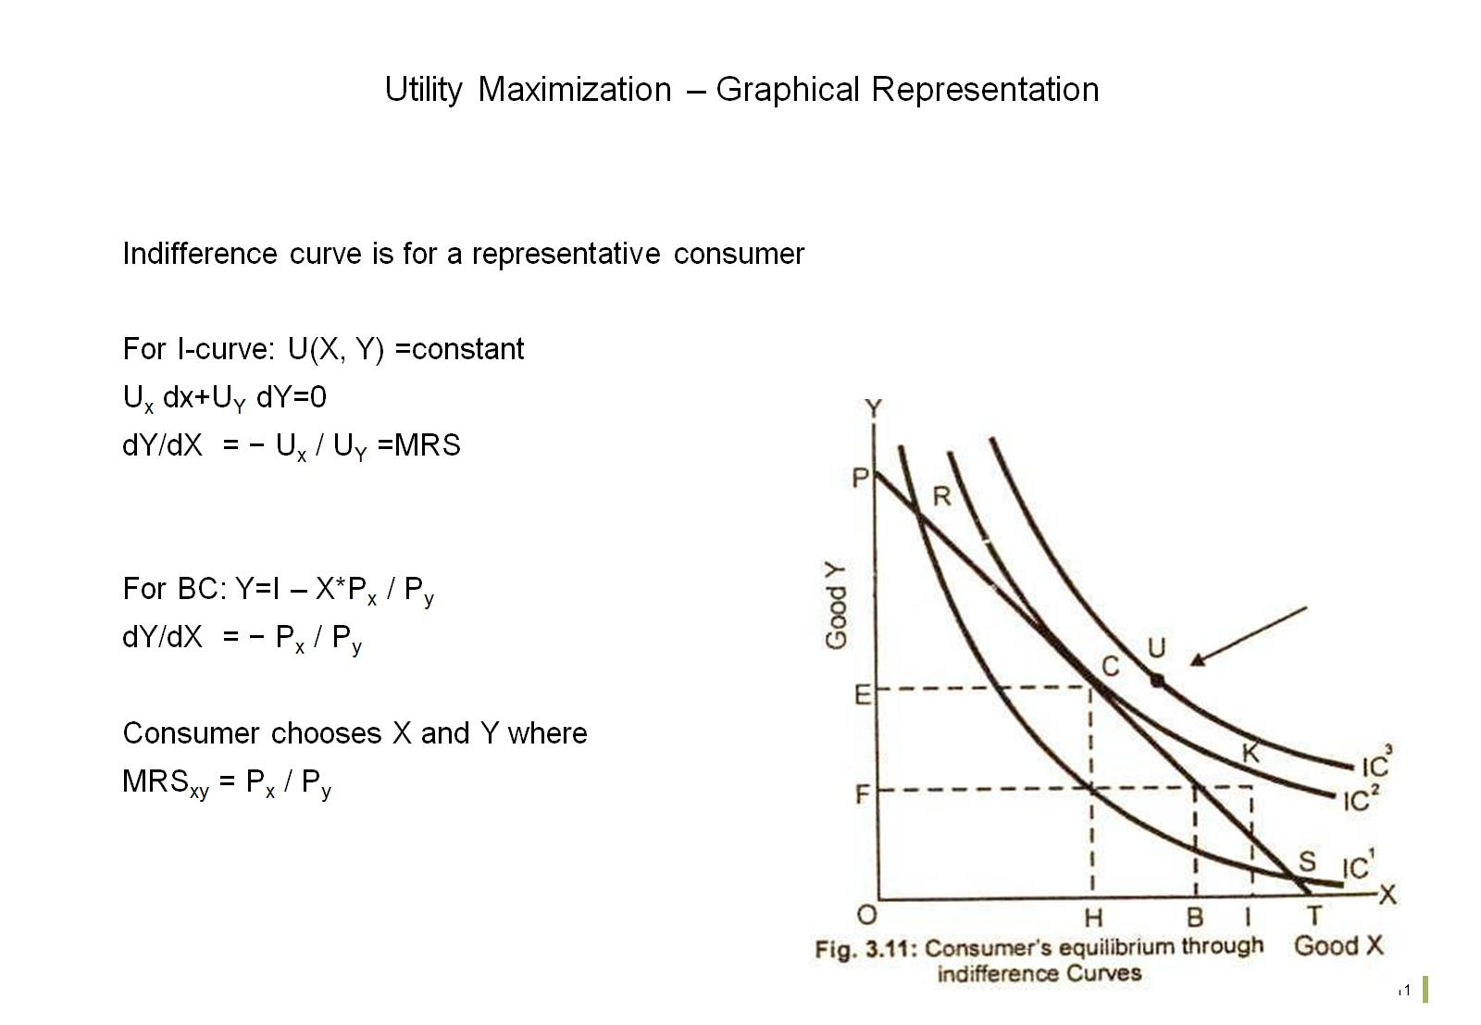
Utility Maximization – Graphical Representation

Slide 13
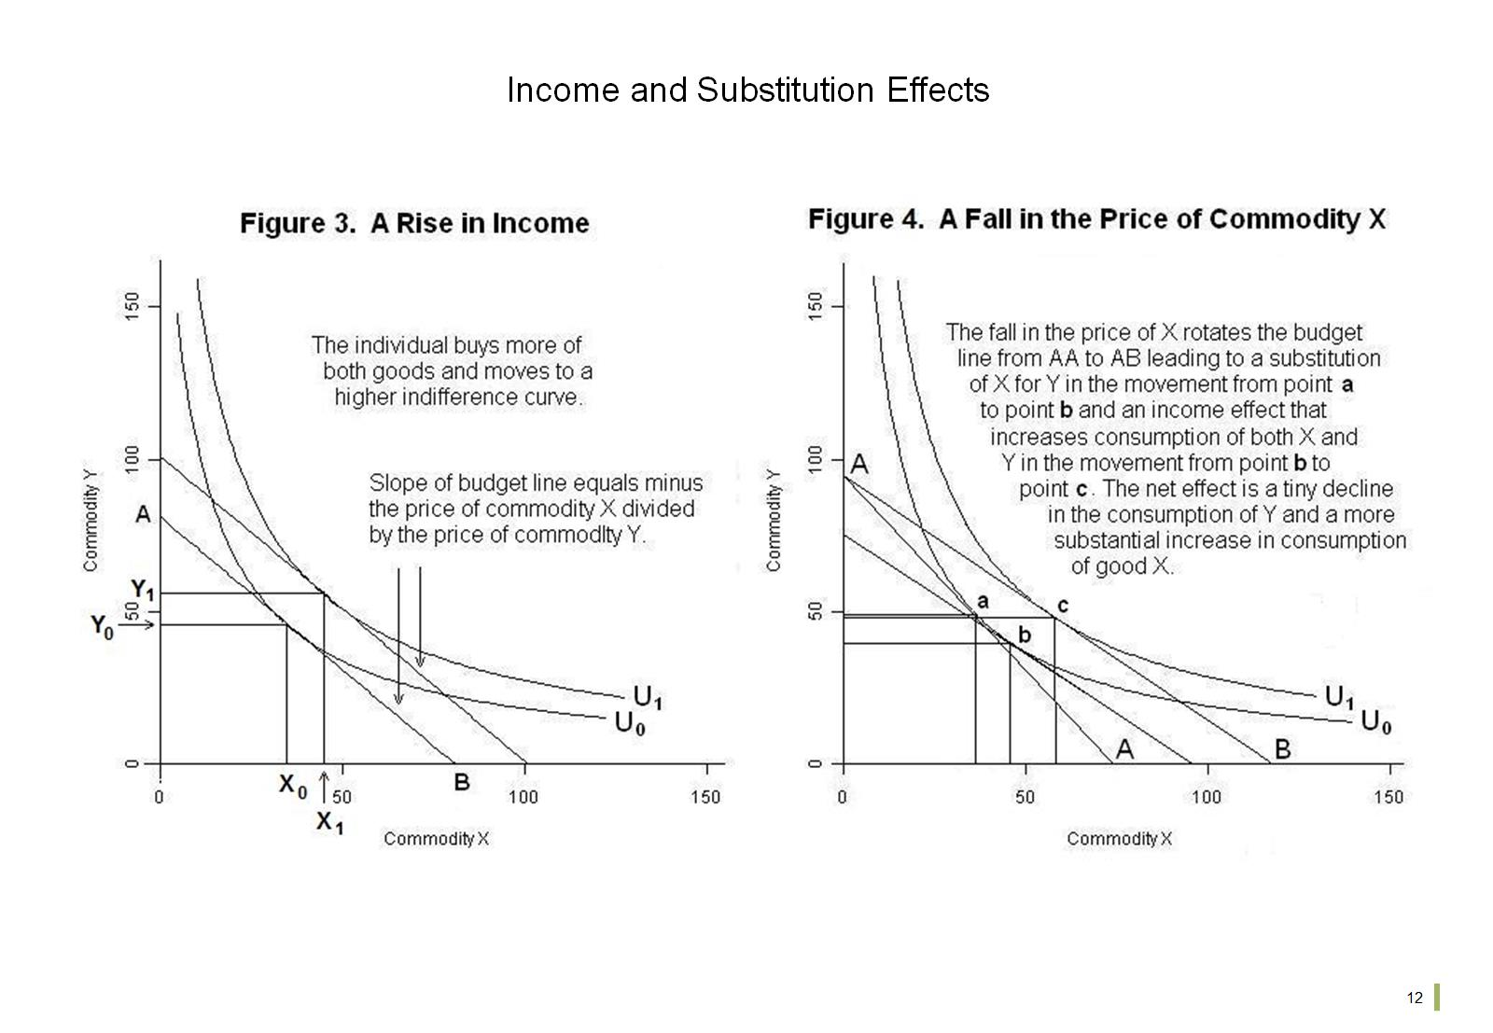
Income and Substitution Effects

Slide 14
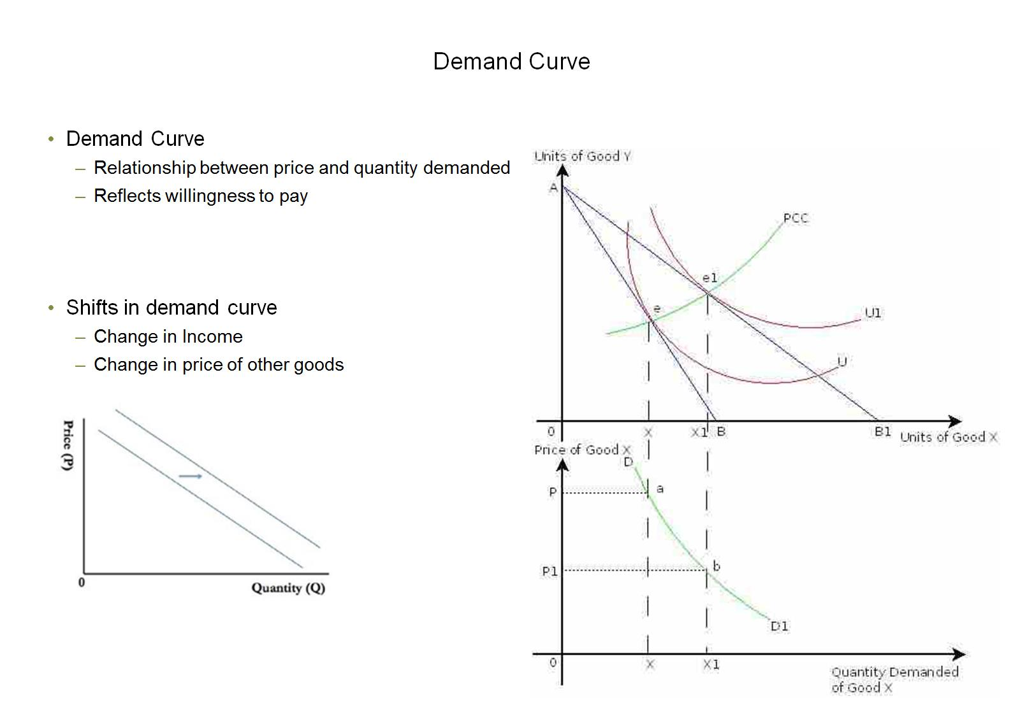
Demand Curve

